Slide 1
A Summary of my Research at ASU
Sagnik Dasgupta
08/13/2020

Slide 2
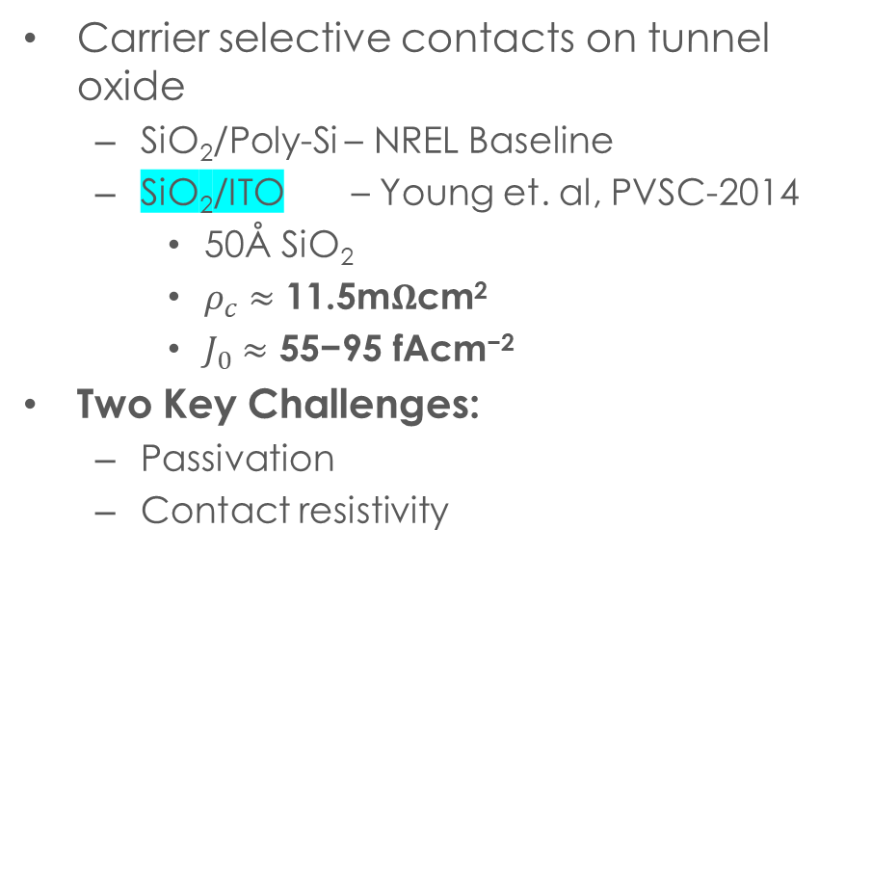
Transparent, passivating, and carrier-selective contacts to silicon solar cells
Carrier selective contacts on tunnel oxide
SiO₂/Poly-Si – NREL Baseline
SiO₂/ITO – Young et. al, PVSC-2014
50Å SiO₂
$ρ_{c}≈\text{11.5}\text{m}Ω\text{cm}\text{2}$
$J_{0}≈\text{55−95 }\text{fAcm}\text{−2}$
Two Key Challenges:
Passivation
Contact resistivity
n poly
SiO_{x} (1. 5nm)
Si
SiO_{x} (1.5 nm)
p poly
ITO
SiO_{x} (1. 5nm)
Si
SiO_{x} (1.5 nm)
p poly

Slide 3
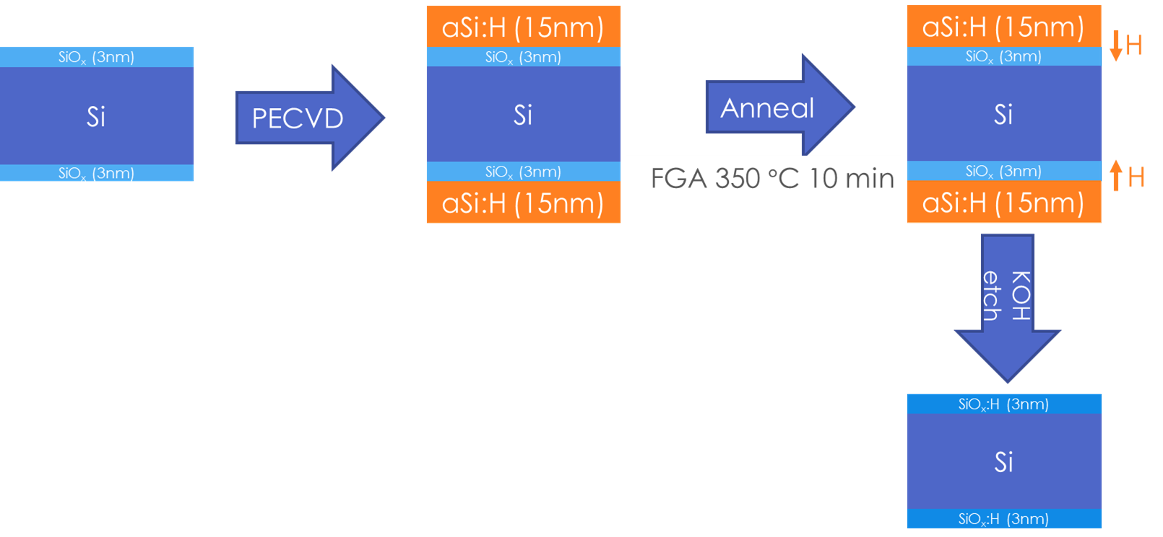

Challenges in Experimental realization - Passivation
SiO₂ is the passivation layer
2 necessities for effective passivation*
Hydrogen radicals for dangling bonds
Capping layer on oxide
PECVD aSi:H capping layer and hydrogen source
Hydrogen overpressure in forming gas promotes diffusion into SiO₂ layer
aSi:H stripped by dilute KOH etch
FGA 350 $°$C 10 min
*Mazzarella, L. et al. Optimization of PECVD process for ultra-thin tunnel SiO x film as passivation layer for silicon heterojunction solar cells. 2017 IEEE 44th Photovolt. Spec. Conf. PVSC 2017 1–5 (2017). doi:10.1109/PVSC.2017.8366698

Slide 4
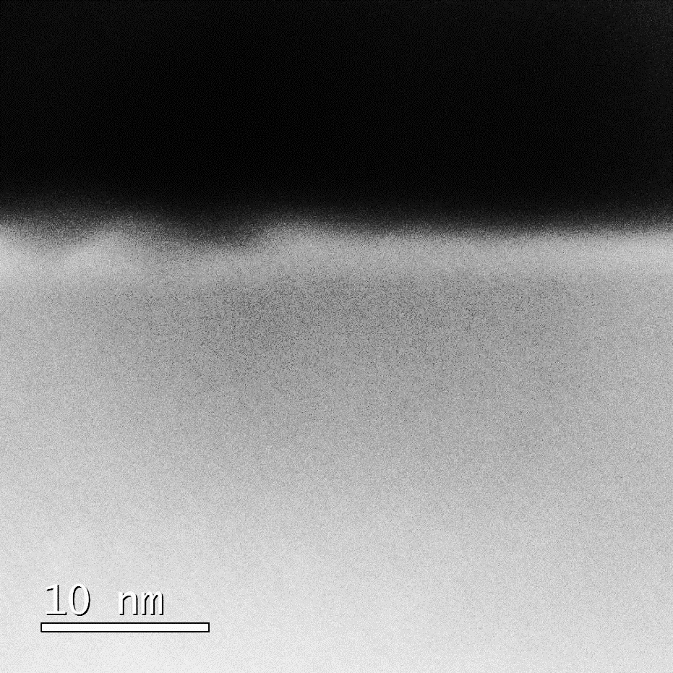


Challenges in Experimental realization – Contact Resistivity
From Fowler-Nordheim tunneling
$$ρ∝\frac{te^{t}}{\tan^{−1}\left(e^{t}\right)}$$
Thicker oxides → Better passivation → Exponentially worse $ρ_{c}$
NREL demonstrated with 5 nm SiO₂ → Too thick for tunneling?
TLM test structures
2 nm SiO₂ + 30 nm ITO
As is → $ρ_{c}$ too high for measurement
600 $°$C Anneal → Measurable resistance, but not ohmic
ITO
ITO
SiO_{x}
Si
ITO
SiO_{x}
ITO reacting with SiO_{x} ?
Effective thickness reduced
To do: EDX
Si

Slide 5
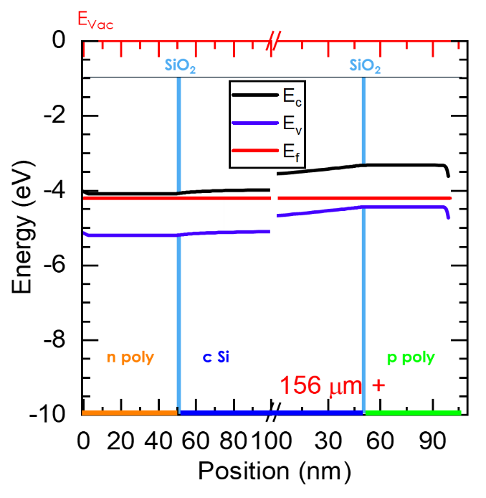
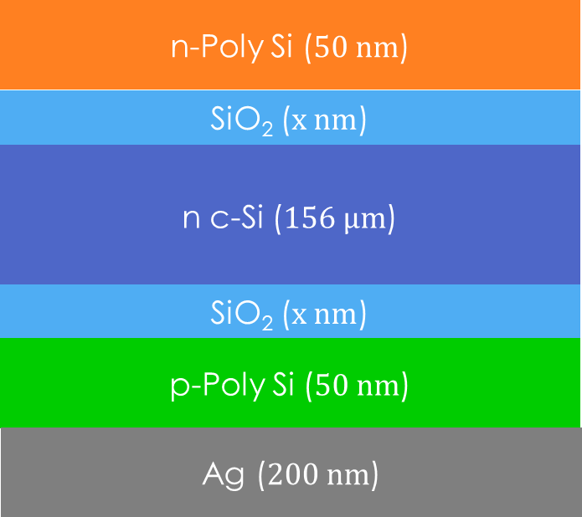

Simulation of TOPCON cells in AFORS-HET
Reference TOPCON model in AFORS-HET v2.5¹
Goal: Model device similar to NREL baseline
Defects in cSi/SiO_{x} interface
1 Å transition layer
${10}^{17} cm^{−3} eV^{−1}$ defect density at midgap²
Tunneling Barrier Height of Oxide
Lower than expected from band alignment³
Adjusted $χ$ and $E_{g}$ to get barrier height 2.5 eV
Results (1.2 nm oxide):
$V_{OC}=721.9 mV$
$J_{SC}=37.3 mA cm^{−2}$
$η=20.48 \%;FF=83.66 \%$
Conclusions:
Fairly realistic representation of NREL’s baseline
Reference for comparing to devices with novel contacts
1. Varache, R. et al. Investigation of selective junctions using a newly developed tunnel current model for solar cell applications. Sol. Energy Mater. Sol. Cells 141, 14–23 (2015).
2. King, T. J., Hack, M. G. & Wu, I. W. Effective density-of-states distributions for accurate modeling of polycrystalline-silicon thin-film transistors. J. Appl. Phys. 75, 908–913 (1994).
3. Gan, J.-Y. Polysilicon emitters for silicon concentrator solar cells. (Stanford University, 1990).

Slide 6
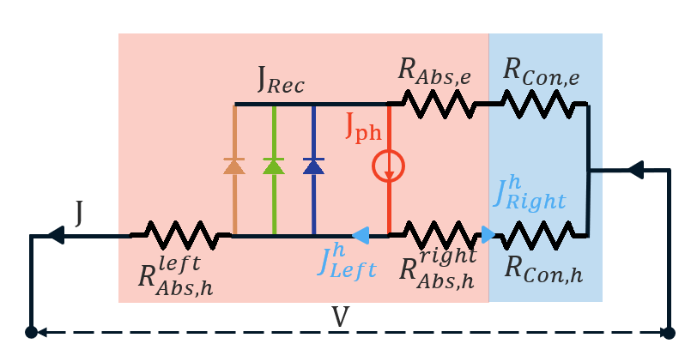
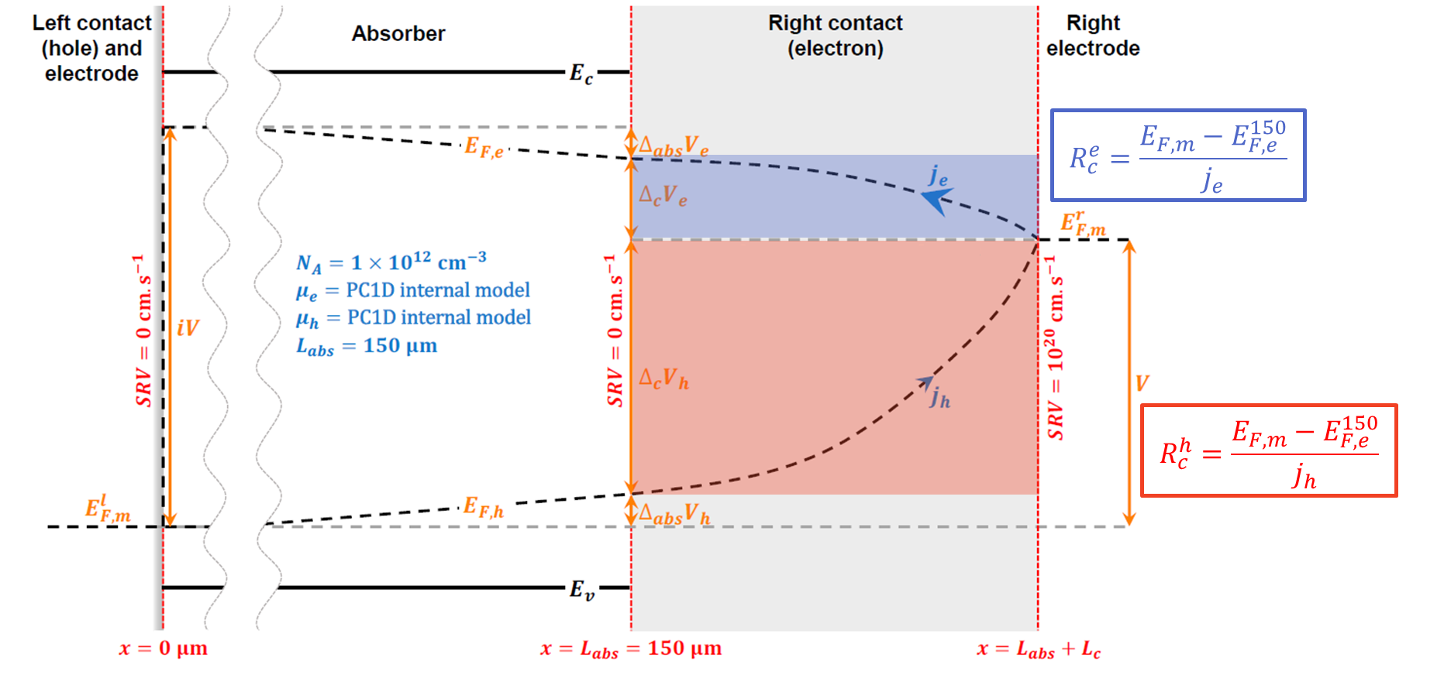

Partial Specific Contact Resistances as a Proxy for Device performance
Simulations in PC1D, Analyzed in MATLAB
Goal:
Obtain electron and hole partial contact resistances
Function of iV
From iJV and JV
Simulation assumptions
Ideal electron contact
Uniform generation in the absorber
PC1D data
(J-iV; J-V)
Solve for $R_{Tot,h}$ & $R_{Tot,e}$ (2e-2v)
Compare with calculated resistances

Slide 7
Calculating the partial Specific Contact resistances
Generation current
$$J\left(\frac{R_{Tot,h}^{Right}}{R_{Tot,e}+R_{Tot,h}}\right)=J_{ph}+J_{0,rad}\left(1−e^{\frac{q⋅iV}{k_{B}T}}\right)+J_{0, Auger}\left(1−e^{\frac{3q⋅iV}{{2k}_{B}T}}\right)+J_{0, SRH}\left(1−e^{\frac{q⋅iV}{{2k}_{B}T}}\right)−\frac{iV}{R_{Tot,e}+R_{Tot,h}}$$
Radiative recombination
Auger recombination
Shockley-Read-Hall recombination
$$V=\left(J_{ph}+J_{0,rad}\left(1−e^{\frac{q⋅iV}{k_{B}T}}\right)+J_{0, Auger}\left(1−e^{\frac{3q⋅iV}{{2k}_{B}T}}\right)+J_{0, SRH}\left(1−e^{\frac{q⋅iV}{{2k}_{B}T}}\right)\right)×R_{Tot,h}^{Right}−J\left(R_{Abs,h}^{Left}+R_{Tot,h}^{Right}\right)$$

